Slide 1




ONLINE
MARKETPLACE
Presented by: Team #

Slide 2

OVERVIEW
01
02
03
Our Team
Challenge
Objectives
04
05
06
Features
Phases of Development
Demo
07
08
09
What Sets Us Apart
Contact Information
Q&A Session

Slide 3



ABOUT US
MOHAMED HESHAM
AHMED SAMEH
BASEL MAHMOUD
AHMED MOHAMED

Slide 4





CHALLENGE BUSINESSES FACE TODAY
01
Limited Reach:
Physical stores are restricted to local markets.
High Costs:
Managing physical stores consumes significant resources.
02
Fragmented Customer Experience:
No centralized management tools for customer engagement.
03
Solution:
A modern e-commerce platform

Slide 5






WHY CHOOSE ONLINE MARKETPLACE?
All-in-One Platform
Manage products, payments, and orders from one place
Cost-Effective
Reduces the need for multiple tools by centralizing operations
Multi-Device Support
Accessible from desktop, tablet, and mobile devices

Slide 6

OBJECTIVES
User-Friendly
Build an intuitive marketplace with essential e-commerce features.
Business Empowerment
Provide tools for growth and customer engagement.
Security & Reliability
Integrated payment systems and order tracking ensure smooth transactions.

Slide 7

PROJECT FEATURES
Product Management
User Accounts
Payment Handling
Customer Reviews
Cart Management
Order Management
Product Categories

Slide 8


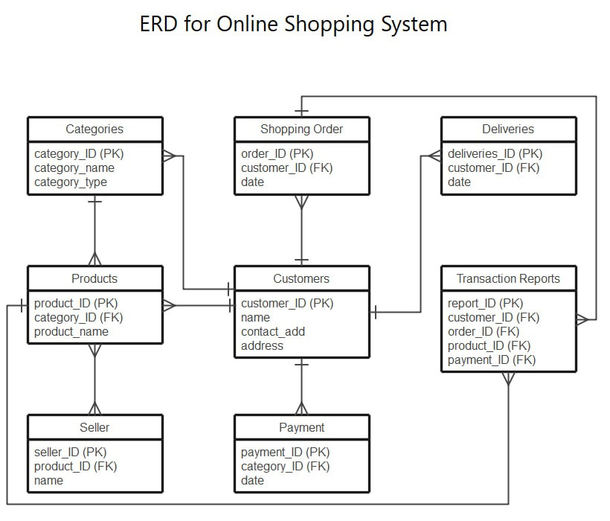
ERD

Slide 9




PHASES OF DEVELOPMENT
Analysis
Design
Implementation
Identified user needs and core e-commerce features.
Conducted market research to study competitors and industry trends.
Created wireframes and UI/UX prototypes for customer and admin interfaces.
Designed SQL database schema for managing products, users, orders.
Developed core controllers
Testing & Deployment:

Slide 10
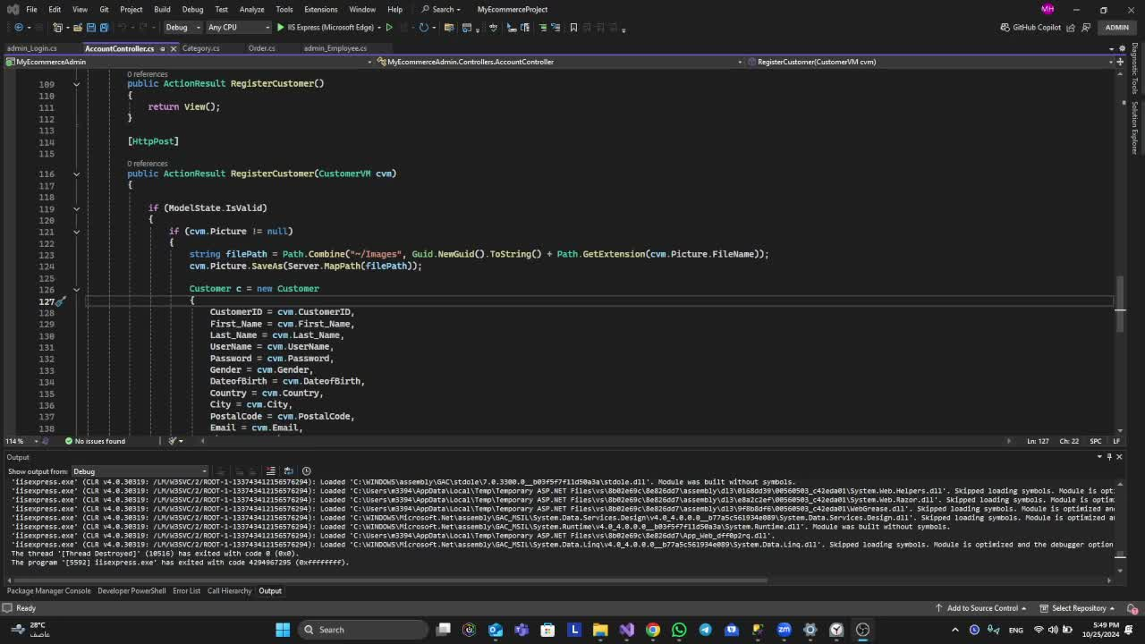
DEMO 1

Slide 11
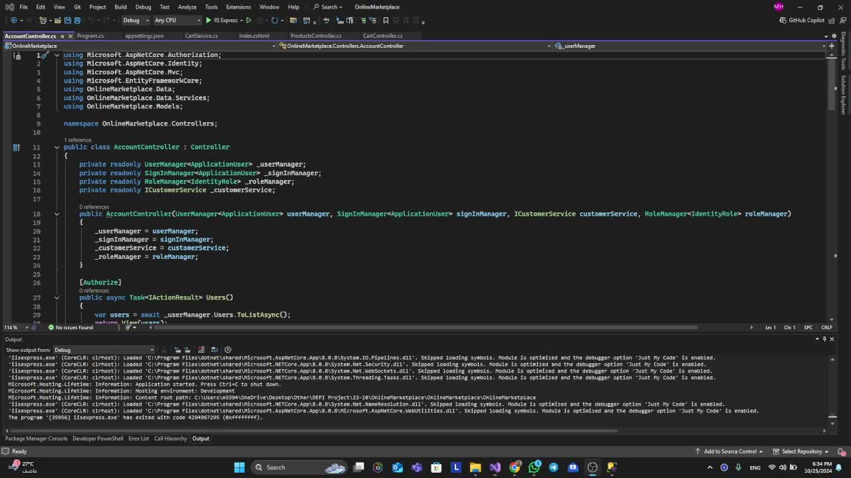
DEMO 2

Slide 12

WHAT SETS US APART ?
Performance Optimized:
.NET MVC ensures fast and responsive operation.
User-Friendly Interface:
Simple and intuitive design for both businesses and customers
Secure Architecture:
Ensures data protection with robust security measures.
Scalable:
Modular design allows for easy feature expansion.

Slide 13



TARGET USERS & BENEFICIARIES
Small & Medium Businesses
Startups & Entrepreneurs
Freelancers & Artisans
Retail Stores

Slide 14



Pricing Plans
Free Tier
Standard Plan
Enterprise Plan
Basic
features for small
businesses
advanced analytics and priority support
complete management tools
$
0.00
$
139
$
145

Slide 15








IDE/Editor
Frameworks
Database Management
The most popular and powerful integrated development environment (IDE) for .NET development. It provides a rich set of features like debugging, IntelliSense, Git integration, and more.
The most popular and powerful integrated development environment (IDE) for .NET development. It provides a rich set of features like debugging, IntelliSense, Git integration, and more.
A framework that implements the Model-View-Controller (MVC) pattern, separating concerns and making web development more maintainable.
Tools
FrontEnd
Testing
HTML/CSS/JavaScript: Core web technologies for designing and building the front-end of the web application.
A tool to test and debug REST APIs, which are often a part of web applications built in .NET.

Slide 16



Thank's For Watching
19929
support@marketplace.com

Slide 17


Q&A Session
Looking forward to their feedback and suggestions.

